Slide 1

Final Project Presentation
Brandee Fairnot
GameCo. 2017 Projections

Slide 2
Executive Expectations
The assumption is that all region sales have remained constant over time. If true, GameCo should keep investing the same resources in all regions.
Notes:
First, set the scene for your audience: What's the current understanding of how video game sales behave across geographic regions? Articulate this as a statement and place it at the start of a new file.

Slide 3
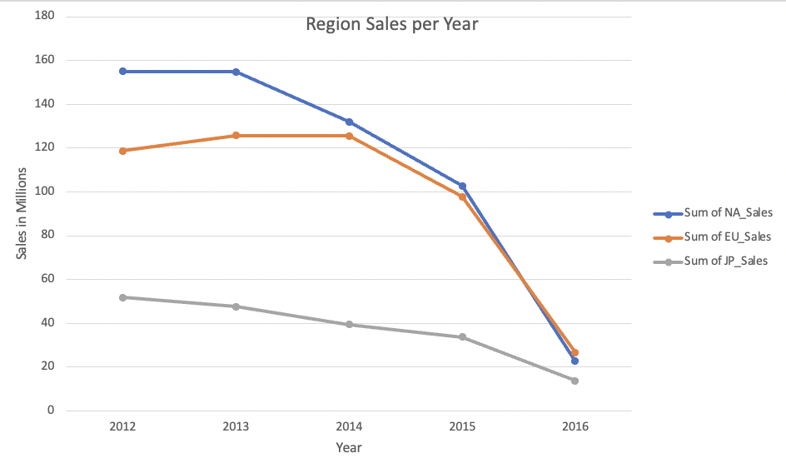
Notes:
Visualization:
This line chart shows the decline in sales from 2012 to 2016. Since the data is not given on a month by month basis for 2016, it has been broken down by year. I chose this chart because the executives won’t care about the data before 2000 and may not care about any data before 2010. The data displayed shows the steep decline over the past few years which is relevant to the current sales. It also shows that in 2016 European sales were higher than North American sales for the first time in multiple years. This is a good indication of which region GameCo. should be focused on.

Slide 4
Insight
Through 2016, video game sales have had a steep decline from previous years for all regions. In the past 4 years, sales have declined by more than half the previous revenue.
The regions have shown that the European market has surpassed the North American market by a $1-2 million in sales. Japan has been behind both markets per usual, but with the other two regions declining so rapidly, they are almost in par with Japan annual sales.
This challenges the original idea that sales were constant because the decline of sales is happening in all three regions.
Notes:
- Write a clear statement to draw the executives’ attention to the main insight shown in the visualization(s)
- explain how your insight supports or challenges GameCo’s current understanding.

Slide 5
New Expectation
The new expectation is that sales will continue to decline for 2017 based in the downward trend the line graph keeps displaying for all three regions.
Notes:
First, set the scene for your audience: What's the current understanding of how video game sales behave across geographic regions? Articulate this as a statement and place it at the start of a new file.

Slide 6
Action Plan
GameCo should focus on the European market since they slightly outsold the North American market, but the American market should not be decreased by too much since they are almost even to the European sales.
The company should investigate mobile gaming since that is a viable source to increase revenue in all regions
The next slide displays the genres sales of each region to aid the executives in decision making of which types of games to focus on for each region to receive the best return of investment.
Notes:
Recommend an action that GameCo could take in light of this revision.

Slide 7
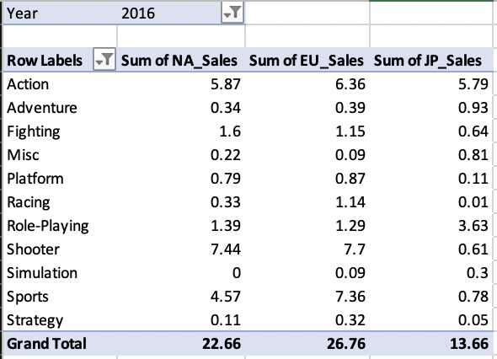
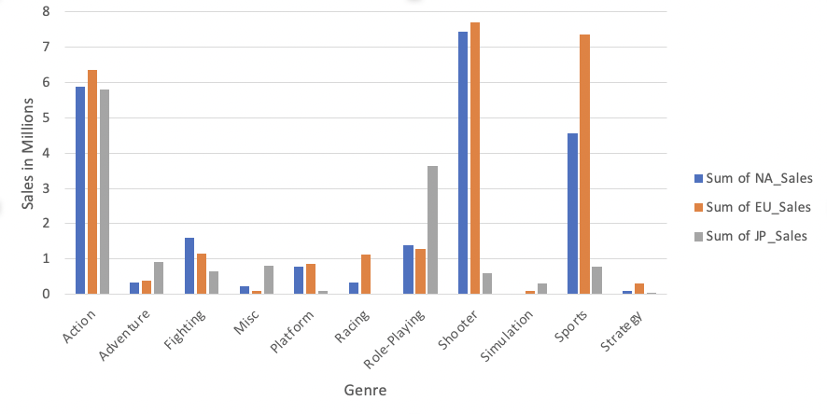
2016 Region Sales by Genre
Notes:
Visualization:
This clustered bar graph was created to show the 2016 sales per genre. The 1st graph explains the decline in sales, while this graph gives more insight to which genres & regions should be targeted to get the best return on investment for GameCo. This chart shows that the shooter genre is the best selling games for North America and Europe, while Japan’s best selling genre is action.
Top 3 genres per region:
Europe: 1) Shooter 2) Sports 3) Action
North America: 1) Shooter 2) Action 3) Sports
Japan: 1) Action 2) Role Playing 3) Adventure

Slide 8
Any Questions?

